Slide 1

Sources of Variability and Bias in small RNA sequencing
Starting Amount
sRNA Purification
Adapter Ligation Bias
Amplification Bias

Slide 2
Current microRNA kits available
 | Kit | Disadvantage | Starting RNA | Price per sample | Preferential ligation bias considered? | Account for dimer bias? | Note
1 | Clontech -SmarterSeq |  | 1ng | $111.67 | Yes, Ligation independent- uses RNA 3' polyadenylation and SMART (switching mechanism at the 5' end of RNA template) which is sequence-independent | No- probably ok if you use correct starting amount | Could be pretty good for bias
2 | BIOO-NextFlex |  | 5ng + for gel prep, 200ng+ for gel free prep | $65.63 | Yes, ligation- uses randomized adapters | Yes, adapter-dimer reduction | Best correlated with qPCR over Illumina TrueSeq –suggested for bias – can do without gel
3 | seqmatic - Tailormix miRNA sample preparation kit V2 |  | 10 -100 ng total RNA input | $90 | Don’t think so | Yes, gel extraction to reduce adapter-dimers | Could be OK for bias
4 | seqmatic - Tailormix miRNA sample preparation kit gel-free |  | 150 ng total RNA input | $90 | Don’t think so | Don’t think so | No gel required
5 | NEBNEXT |  | 100ng-1ug | $61.25 | Don’t think so | Yes, adapter-dimer removal | most commonly used after Tuseq, should be OK for bias
6 | Ambion | might require more RNA or purification | 100ng if purified, less than 1 micro gram if not | ??? | Don’t think so | Don’t think so | Probably not a good option
7 | Applied Biosystems (from Ambion) SOLiD | Compatible? | 10-250ng | $61 | Yes, Altered adaptors to reduce ligation bias | No | Could be quite good for bias but may not be very compatible with sequencing
8 | Trilink-CleanTag |  | 1-1000ng | $70.63 | Don’t think so | Yes, adapters block adapter-adapter ligation to reduce dimer production | Could be OK for bias, can do without gel
9 | Illumina-TrueSeq | High starting amount | 1000ng | $100 | Maybe…Adapters are short, so this may reduce bias, no dimer reduction involved- so will get dimers if use lower than recommended starting amount | No, but should not have any if use correct starting amount | Known to be gold standard Indexing/barcoding during PCR – after ligation (not directly to miRNA reduces bias)

Slide 3
Current microRNA kits in comparison Study
 | Kit | Disadvantage | Starting RNA | Price per sample | Preferential ligation bias considered? | Account for dimer bias? | Note
1 | Illumina-TrueSeq | High starting amount | 1000ng | $100 | Maybe…Adapters are short, so this may reduce bias, no dimer reduction involved- so will get dimers if use lower than recommended starting amount | No, but should not have any if use correct starting amount | Known to be gold standard Indexing/barcoding during PCR – after ligation (not directly to miRNA reduces bias)
2 | BIOO-NextFlex |  | 5ng + for gel prep, 200ng+ for gel free prep | $65.63 | Yes, ligation- uses randomized adapters | Yes, adapter-dimer reduction | Best correlated with qPCR over Illumina TrueSeq –suggested for bias – can do without gel
3 | NEBNEXT |  | 100ng-1ug | $61.25 | Don’t think so | Yes, adapter-dimer removal | most commonly used after Tuseq, should be OK for bias
4 | Clontech -SmarterSeq |  | 1ng | $111.67 | Yes, Ligation independent- uses RNA 3' polyadenylation and SMART (switching mechanism at the 5' end of RNA template) which is sequence-independent | No- probably ok if you use correct starting amount | Could be pretty good for bias

Slide 4
Reproducibility Tests
SET1: in triplicate
New England | Illumina | Next Flex | Clontec
100ng | 1000ng | 100ng | 100ng
250ng | 1500ng | 250ng | 250ng
500ng | 2000ng | 500ng | 500ng
1000ng |  | 1000ng | 1000ng
 |  | 1500ng | 1500ng
 |  | 2000ng | 2000ng
Kit suggests: 100-1,000ng | Kit suggests: 1,000ng + | Kit suggests: 1ng - 2,000ng | Kit suggests: 1ng - 2,000ng
SET2 : in triplicate
New England | Illumina | Next Flex | Clontec
1000ng | 1000ng | 1000ng | 1000ng
Kit suggests: 100-1,000ng | Kit suggests: 1,000ng + | Kit suggests: 1ng - 2,000ng | Kit suggests: 1ng - 2,000ng

Slide 5
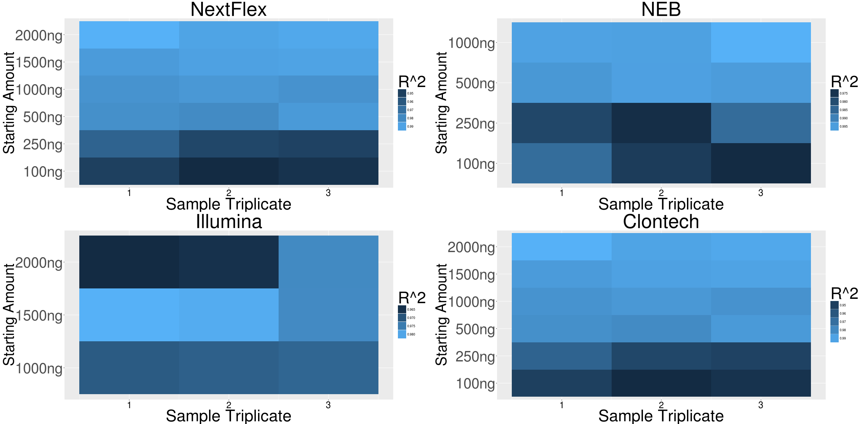
Titration Test : 500ng appears to be the lower limit for Reproducibility

Slide 6
Reproducibility Results
SET1: in triplicate
New England | Illumina | Next Flex | Clontec
100ng | 1000ng | 100ng | 100ng
250ng | 1500ng | 250ng | 250ng
500ng | 2000ng | 500ng | 500ng
1000ng |  | 1000ng | 1000ng
 |  | 1500ng | 1500ng
 |  | 2000ng | 2000ng
Kit suggests: 100-1,000ng | Kit suggests: 1,000ng + | Kit suggests: 1ng - 2,000ng | Kit suggests: 1ng - 2,000ng
1000ng Results | Clontech | ILLUMINA | NEB | NEXT
correlation | 0.941 | 0.985 | 0.980 | 0.993
Rank | 4 | 2 | 3 | 1
500ng Results | Clontech | NEB | NEXT
correlation | 0.924 | 0.981 | 0.992
Rank | 3 | 2 | 1

Slide 7
Accuracy Test
Accuracy Test | New England | Illumina | Next Flex | Clontech
Synthetic miRNA | 300ng | 300ng | 300ng | 300ng
miRXplore Universal Reference (Miltenyi Biotec Inc.),
an equimolar pool of 963 synthetic miRNAs
Species | Kit | Illumina | NEB | NEXT | Clontech
Human | RMSE | 3.12 | 2.97 | 2.51 | 2.21
Mouse | RMSE | 3.15 | 3.04 | 2.4 | 2.2
Rat | RMSE | 3.15 | 3.01 | 2.4 | 2.21
Virus | RMSE | 3.11 | 2.59 | 2.57 | 2.12
 | Rank | 4 | 3 | 2 | 1

